Slide 1

Machine Learning Final Presentation
Chen, Ting-Yin
8th Jan. 2020

Slide 2

Outline
01.
Condition GAN Model
02.
Generator
03.
Discriminator
04.
Experiment

Slide 3
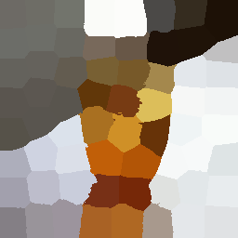
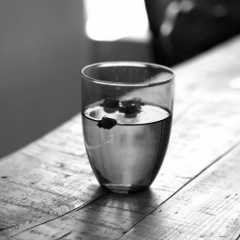
As close as possible
Real Color
Mosaic images
Grayscale image
Generator
Image
G(L)
Discriminator
T or F
Mosaic images
Grayscale image

Slide 4
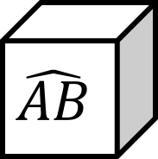
Generator
L
$$\hat{AB}$$
Encoder
Decoder
Mos

Slide 5
Discriminator
L
C
(predict)
AB

Slide 6


Object function
$L$ is luminance images
$AB$ is real chrominance images
Generator
$min(log\left(1−D\left(L, G(L)\right)\right))+L1$
$L1= \left\|AB −G(L)\right\|$
Discriminator
$max(log\left(1−D\left(L, G(L) \right)\right)+\log\left(D\left(L, AB\right)\right)$)

Slide 7
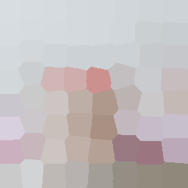
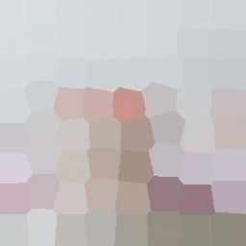
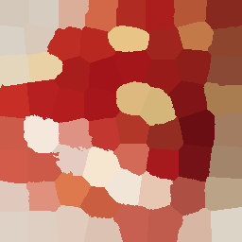
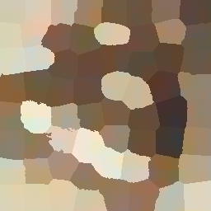
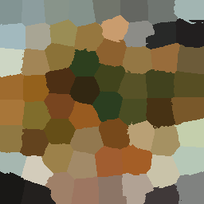

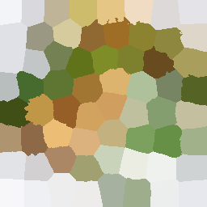
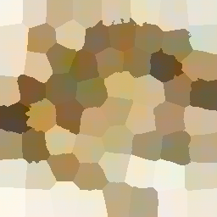
Less parameters
0.0724%
seen
unseen
target
output
target
output

Slide 8
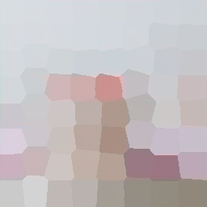
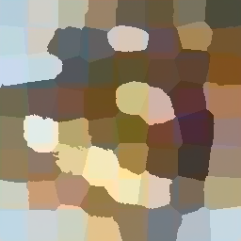

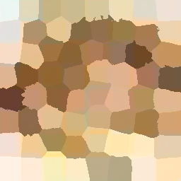
Add parameters
0.1817%
seen
unseen
target
output
target
output

Slide 9
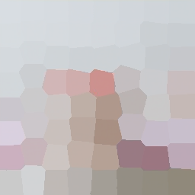
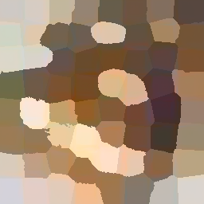
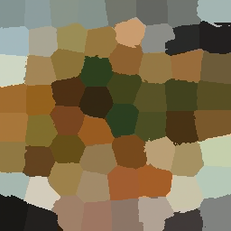
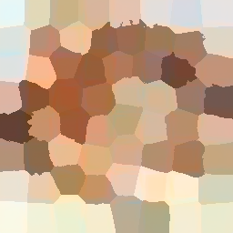
Add parameters
Lambda = 100
seen
unseen
target
output
target
output

Slide 10
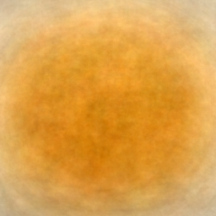
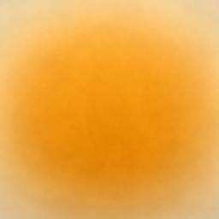
Future Work
The average color image for 400 training images.
Remove or decrease the proportion the L1 term.
Simplify this colorization problem.
Change the method of generator.
The average color image for total training images.

Slide 11
The End

